Slide 1


SELOI HEALTHCARE PVT. LTD.
VITAMIN D QUANTITATIVE RAPID TEST
Instant tests on any smartphone
Take test, click photo and results in 30 seconds

Slide 2



let you track markers anytime, anywhere and with results generated in 30 seconds
Download the Vitamin D App
Take the Test
Results in 30 seconds
Detailed test instructions are available in app. Please download and read them carefully before you begin
Quantitative and shareable results are generated in 30 seconds

Slide 3

Semi - Quantitative results available on phone with a shareable PDF report in seconds

Slide 4






Platform also has additional key features
Easy & Faster ABHA ID Integration
Automatic Digitization
Minimize Human error
Easy monitoring & follow-up process
Available in 30+ Languages
No machine required - no setup cost

Slide 5


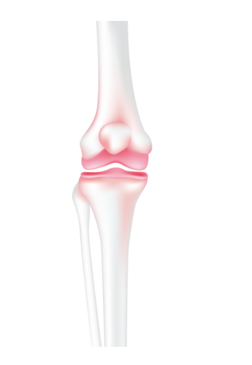


3 Out of 4 Indians suffer from Vitamin D Deficiency
Adequate vitamin D during pregnancy is crucial for the development of the baby's bones and overall health. Vitamin D deficiency during pregnancy can lead to complications like gestational diabetes and preeclampsia. It may also affect the child's long-term health
Important for muscle strength and function. Deficiency can lead to muscle weakness, pain, and an increased risk of falls and fractures, especially in older adults.
It promotes calcium absorption in the gut. This is essential for maintaining strong and healthy bones. Without sufficient vitamin D, the body cannot absorb enough calcium, leading to conditions like osteoporosis (brittle bones) in adults and rickets in children (soft and weak bones).
It has been associated with a reduced risk of infections, including respiratory infections like the common cold and flu. Some research also suggests that adequate vitamin D levels may help the immune system respond effectively to pathogens.
Some studies have suggested that low vitamin D levels may be associated with an increased risk of cardiovascular diseases like hypertension, heart disease, and stroke.
Notes:
Vitamin D plays a vital role in various aspects of health, and its deficiency can have significant implications. Some of the most important health implications of vitamin D are:
1. **Bone Health**: One of the most well-known roles of vitamin D is in promoting calcium absorption in the gut. This is essential for maintaining strong and healthy bones. Without sufficient vitamin D, the body cannot absorb enough calcium, leading to conditions like osteoporosis (brittle bones) in adults and rickets in children (soft and weak bones).
2. **Immune System Function**: Vitamin D may play a role in modulating the immune system. It has been associated with a reduced risk of infections, including respiratory infections like the common cold and flu. Some research also suggests that adequate vitamin D levels may help the immune system respond effectively to pathogens.
3. **Cardiovascular Health**: There is ongoing research into the potential relationship between vitamin D and heart health. Some studies have suggested that low vitamin D levels may be associated with an increased risk of cardiovascular diseases like hypertension, heart disease, and stroke.
4. **Cancer Prevention**: Emerging evidence suggests that vitamin D may play a role in reducing the risk of certain cancers, including breast, prostate, and colorectal cancer. However, more research is needed to establish a definitive link.
5. **Autoimmune Diseases**: Vitamin D may have a protective effect against autoimmune diseases like multiple sclerosis, rheumatoid arthritis, and type 1 diabetes. Some studies suggest that adequate vitamin D levels may help regulate the immune response and reduce the risk of these conditions.
6. **Mood and Mental Health**: There is some evidence to suggest that vitamin D may have a role in mental health. Low vitamin D levels have been associated with conditions like depression and seasonal affective disorder (SAD). However, the exact mechanisms are still being studied.
7. **Pregnancy and Child Development**: Adequate vitamin D during pregnancy is crucial for the development of the baby's bones and overall health. Vitamin D deficiency during pregnancy can lead to complications like gestational diabetes and preeclampsia. It may also affect the child's long-term health.
8. **Muscle Health**: Vitamin D is important for muscle strength and function. Deficiency can lead to muscle weakness, pain, and an increased risk of falls and fractures, especially in older adults.
9. **Autoimmune Diseases**: Some autoimmune diseases, such as multiple sclerosis and rheumatoid arthritis, have been linked to low vitamin D levels. Research is ongoing to understand the precise relationship between vitamin D and autoimmune diseases.
It's important to note that while vitamin D deficiency can have serious health implications, excessive vitamin D intake can also be harmful. Therefore, it's essential to maintain vitamin D levels within the recommended range, which can vary depending on factors like age, sex, and overall health. Consulting with a healthcare provider for regular check-ups and guidance on vitamin D supplementation, if necessary, is advisable.

Slide 6



Slide 7


Slide 8



Slide 9
Thank you!
SELOI HEALTHCARE PVT. LTD.

